Slide 1
NEWS PORTAL
Navaneeth Krishna Tanguturi – 1602-19-737-138
Saketh Verma – 1602-19-737-161
Satwik Kasukurthi – 1602-19-737-165

Slide 2
CONTENTS
ABSTRACT
PROBLEM STATEMENT
SOLUTION STATEMENT
TECHNOLOGY USED
USE CASES
HIGH LEVEL ARCHITECTURE

Slide 3
ABSTRACT
In this modern day, everyone expects to access anything the want within a touch of a button. A Portal is most often one specially designed web page which bring information together from diverse sources in a uniform way. News Portal is an online website of a web-based newspaper that allows the users to catch up on the latest news of various categories such as Politics, Sports, Films etc.

Slide 4
PROBLEM STATEMENT
The manual system of newspaper involves all the clerical work, which is a complicated job. In today’s fast life, it is difficult for the users to get news at their move.

Slide 5
SOLUTION STATEMENT
This news portal will help people to get any news in the world at any time and place, as long as you have an internet connection. People can catch up on the latest news, in that order.
All the news articles will be separated into different categories, thus reducing the time and effort of the user to search for a specific news.
User friendly interface
Older news can also be read, unlike in a newspaper which contains only the news of that particular day.

Slide 6
TECHNOLOGY USED
FRONT-END
HTML: HTML stands for Hyper Text Markup Language, which is the most widely used language on Web to develop web pages and web applications. "Hypertext" refers to the hyperlinks that an HTML page may contain. "Markup language" refers to the way tags are used to define the page layout and elements within the page.
CSS: CSS is the language for describing the presentation of Web pages, including colours, layout, and fonts. CSS saves a lot of work as it enables multiple web pages to share the same style by specifying the relevant CSS in a separate .css file, and reduce complexity and repetition in the structural content.

Slide 7
DATABASES
SQLite:
SQLite is an relational database management system based on SQL – Structured Query Language. SQL is the most popular language for adding, accessing and managing content in a database.
SQLite is open-source i.e., you can use SQLite without paying a dime. Also, if you want, you can change its source code to suit your needs.

Slide 8
BACK-END
Flask:
Flask is a popular Python web framework, meaning it is a third-party Python library used for developing web applications. Flask is a micro web framework written in Python. It is classified as a microframework because it does not require particular tools or libraries

Slide 9
APIs
NewsAPI:
NewsAPI helps locate articles and breaking news headlines from news sources and blogs across the web with a JSON API.

Slide 10
Frameworks
spaCy:
spaCy is an open-source software library for advanced natural language processing, written in the programming languages Python and Cython
NLTK:
The Natural Language Toolkit, or more commonly NLTK, is a suite of libraries and programs for symbolic and statistical natural language processing (NLP) for English written in the Python programming language.
These two frameworks would help us summarize texts using unsupervised learning

Slide 11
Frameworks
pyttsx3 (Text to Speech):
pyttsx3 is a Python Library and CLI tool to interface with Google Translate’s text-to-speech API. Write spoken mp3 data to file, a file-like object(bytestring) for audio manipulation. This would help people who have difficult reading articles.
googletrans:
Googletrans is a free and unlimited python library that implemented Google Translate API. This uses the Google Translate Ajax API to make calls to such methods as detect and translate. This would help us reach international news to everyone in their comfortable dialect

Slide 12
USE-CASES
THE USER
The user is the newspaper reader, who can read any kind of news that he/she wishes to. The user story of the user is:
Register as a new user and login.
Read the news articles by category
Politics
Business
Sports
Film
Tech
World

Slide 13
3. View/Edit profile (includes updating of user information and profile picture)
4. Get the summary, Audio Transcription, Translation of post.
5. Search for live news.
6. Look at the contact details of the newspaper agency
7. Logout
After registration, the user has to wait for the verification by the Administrator. Only after being verified, they can access the portal.

Slide 14
THE EDITOR
The Editor is the person that posts the news articles. The user story of the editor is:
1. Register and login
2. Read the news articles by category
Politics
Business
Sports
Film
Tech
World
3. Add an article

Slide 15
4. View ‘my articles’ (includes the editing option to the already posted articles)
5. View/Edit profile (includes updating of user information and profile picture)
6. Pen a new post
7. Look at the contact details of the newspaper agency
8. Logout

Slide 16
THE ADMINISTRATOR
The Administrator is responsible to verify the newly registered users. Only after being registered by the Administrator, the users can access the news portal. The user story of the Administrator is:
1. Login
2. Read the news articles by category
Politics
Business
Sports
Film
Tech
World
3. View the list of details of Verified Users (includes the blocking and changing the role options)

Slide 17
4. View the list of details of Non-Verified Users (includes verify and delete options)
5. View the list of details of Verified News Articles
6. View the list of details of Non-Verified News Articles
7. View/Edit the profile
8. Look at the contact details of newspaper agency
9. Logout

Slide 18
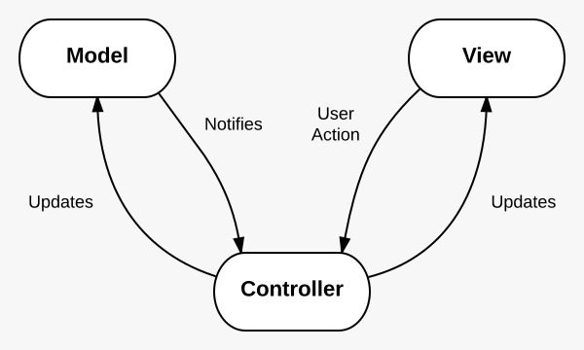
HIGH LEVEL ARCHITECTURE
Flask follow MVC Architecture

Slide 19
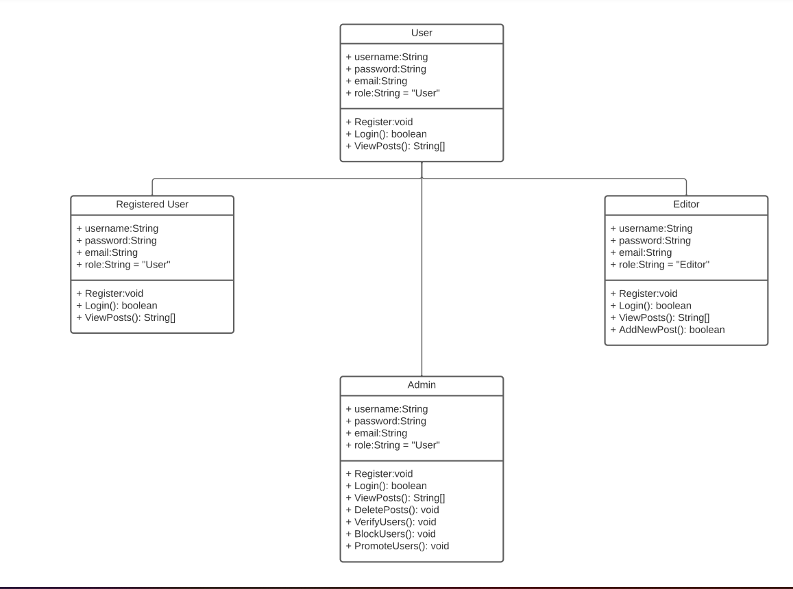
UML DIAGRAMS (Class Diagram)

Slide 20
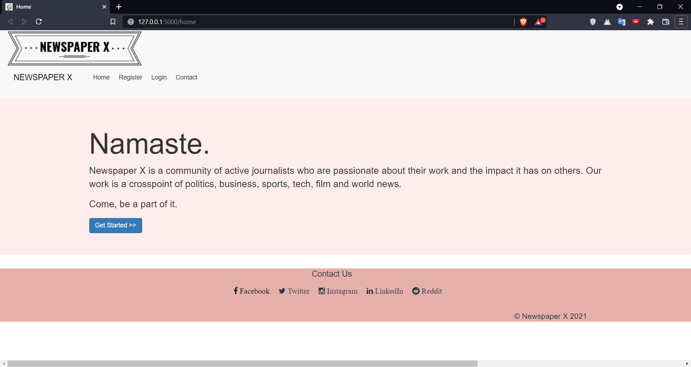
IMPLEMENTATION
Home Page

Slide 21
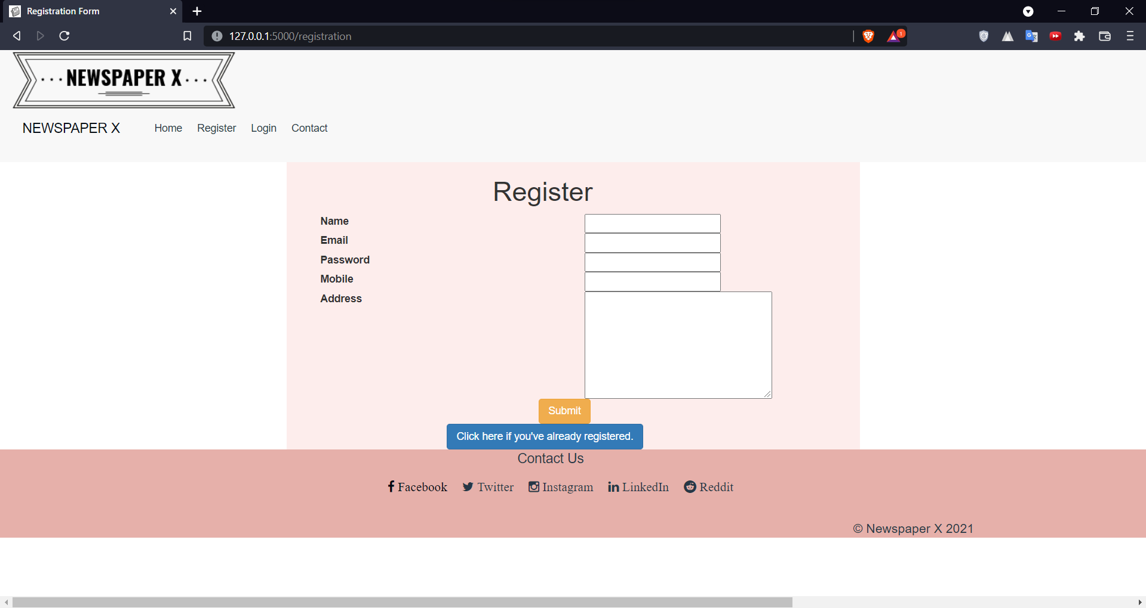
IMPLEMENTATION
Register

Slide 22
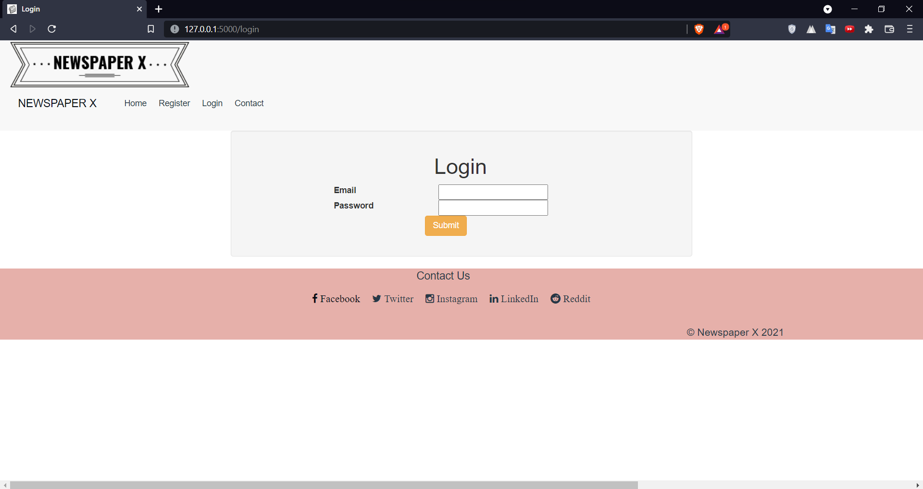
implementation
Login

Slide 23
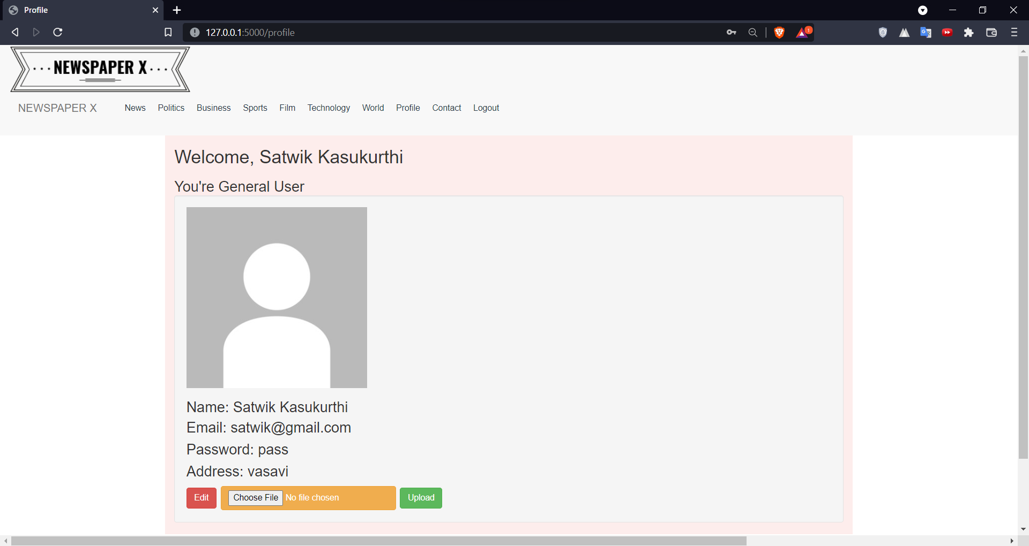
implementation
Profile User can edit his/her details or upload a new image as profile picture.

Slide 24
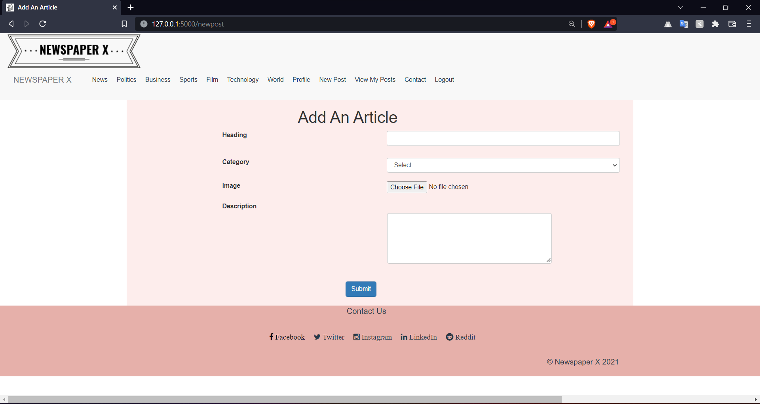
implementation
Add a New Post
Sentiment Analysis is done on the description to make sure no reader is offended

Slide 25
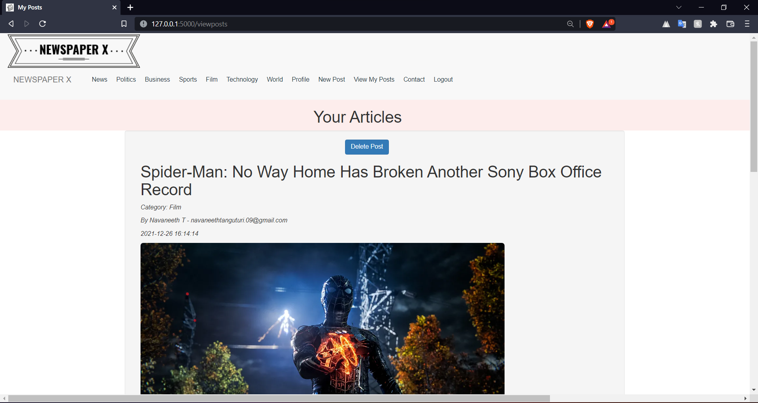
implementation
View Articles
Editor can see all his written articles here and can choose to delete them.

Slide 26
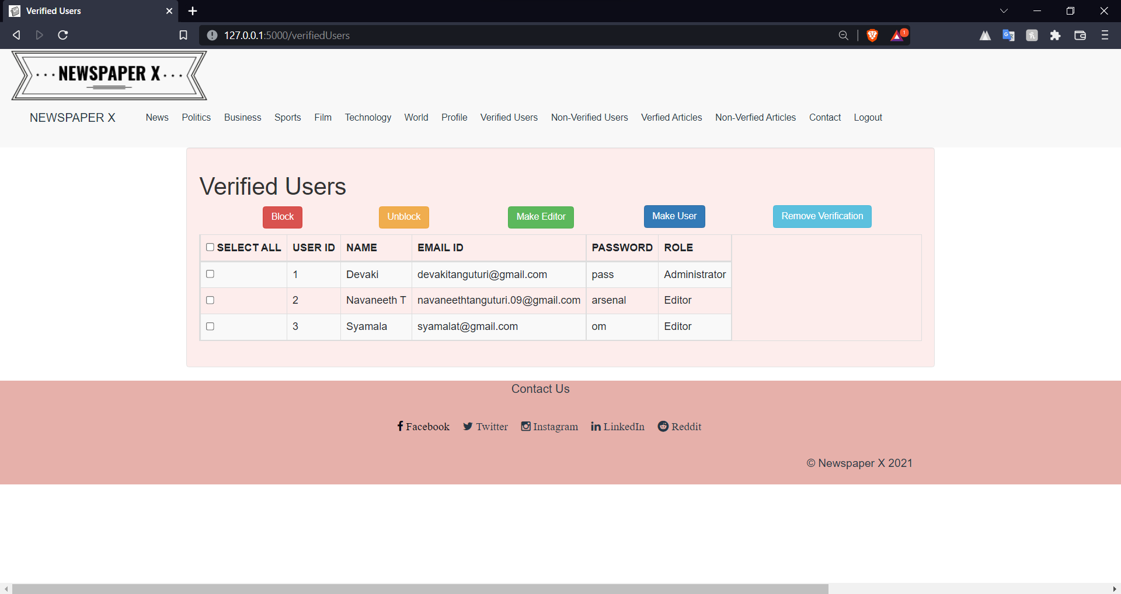
implementation
Verifying/Promoting/ Blocking Users
This is exclusive to Admin only

Slide 27
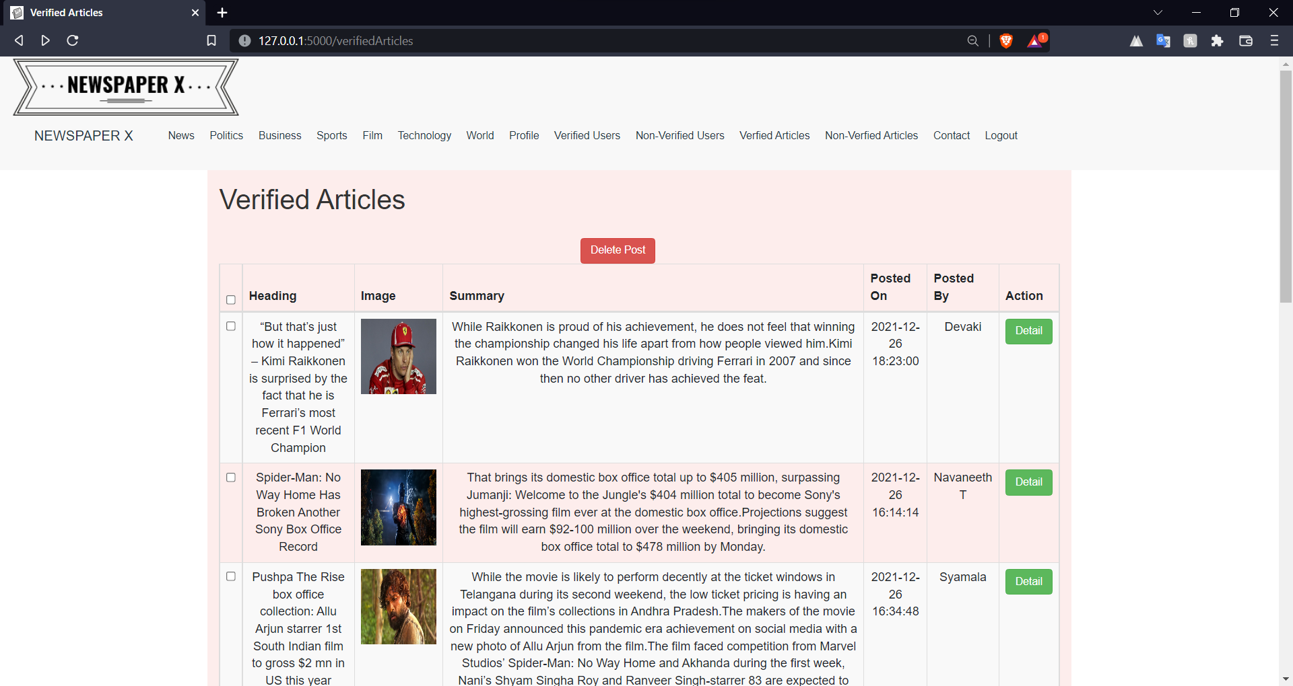
implementation
Verified Articles

Slide 28
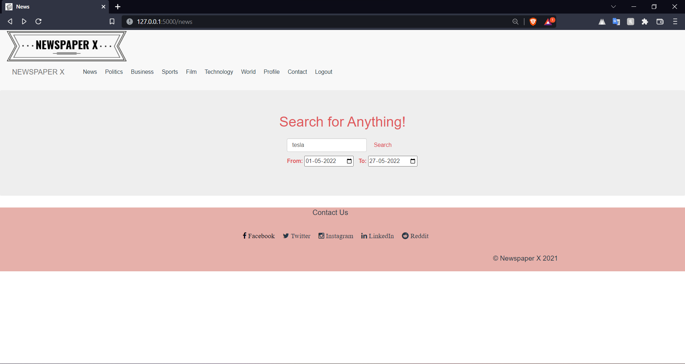
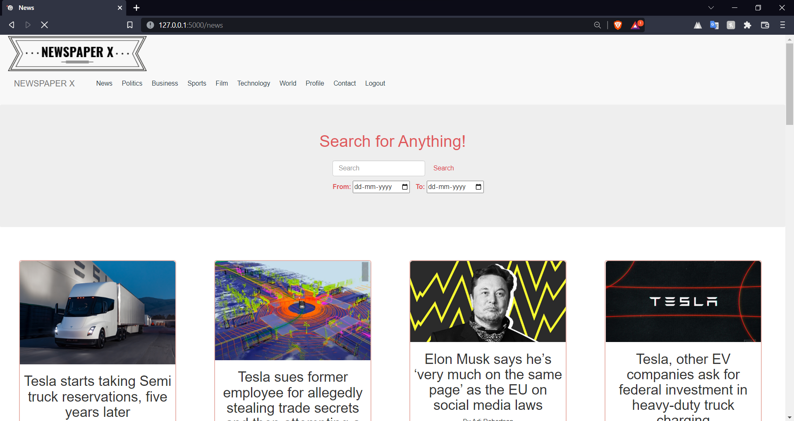
implementation
Searching for Live News

Slide 29
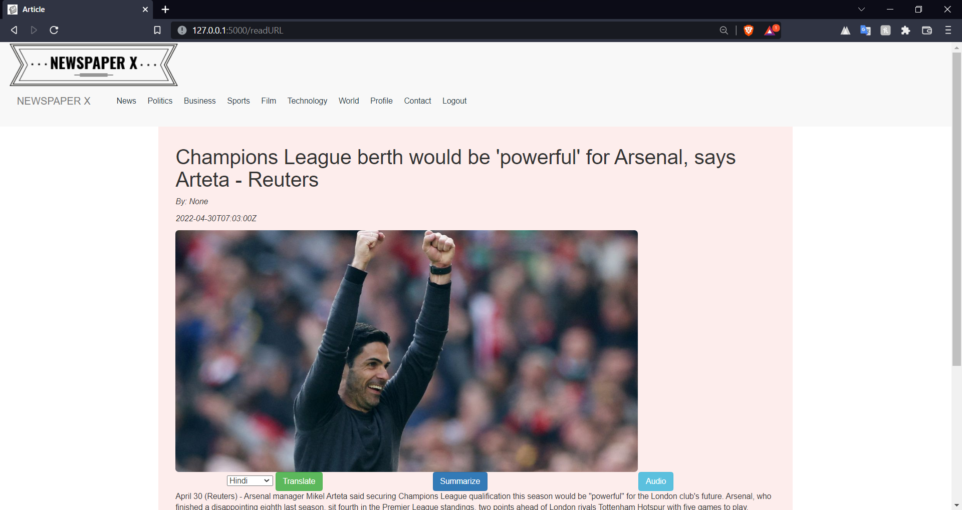
implementation
Reading Full Post/Live News Post User can get the summary, Audio transcription or can Translate it to language one is comfortable with.

Slide 30
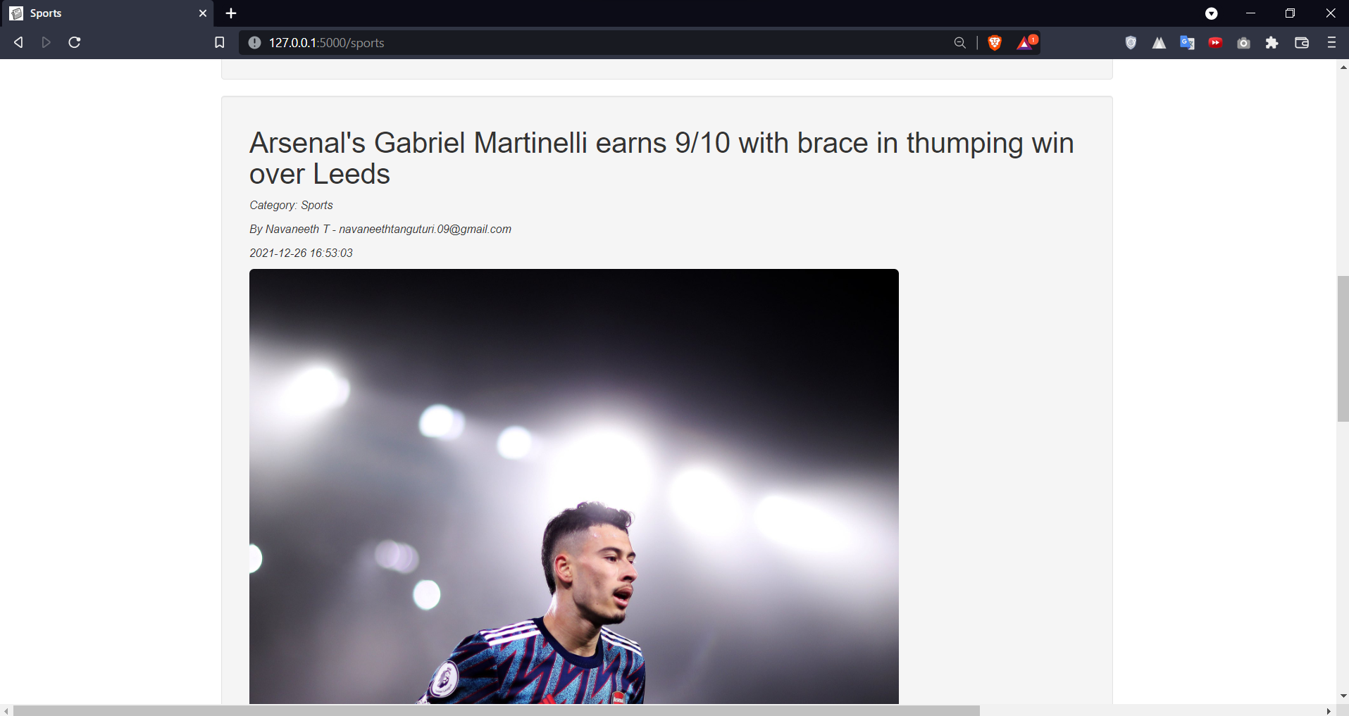
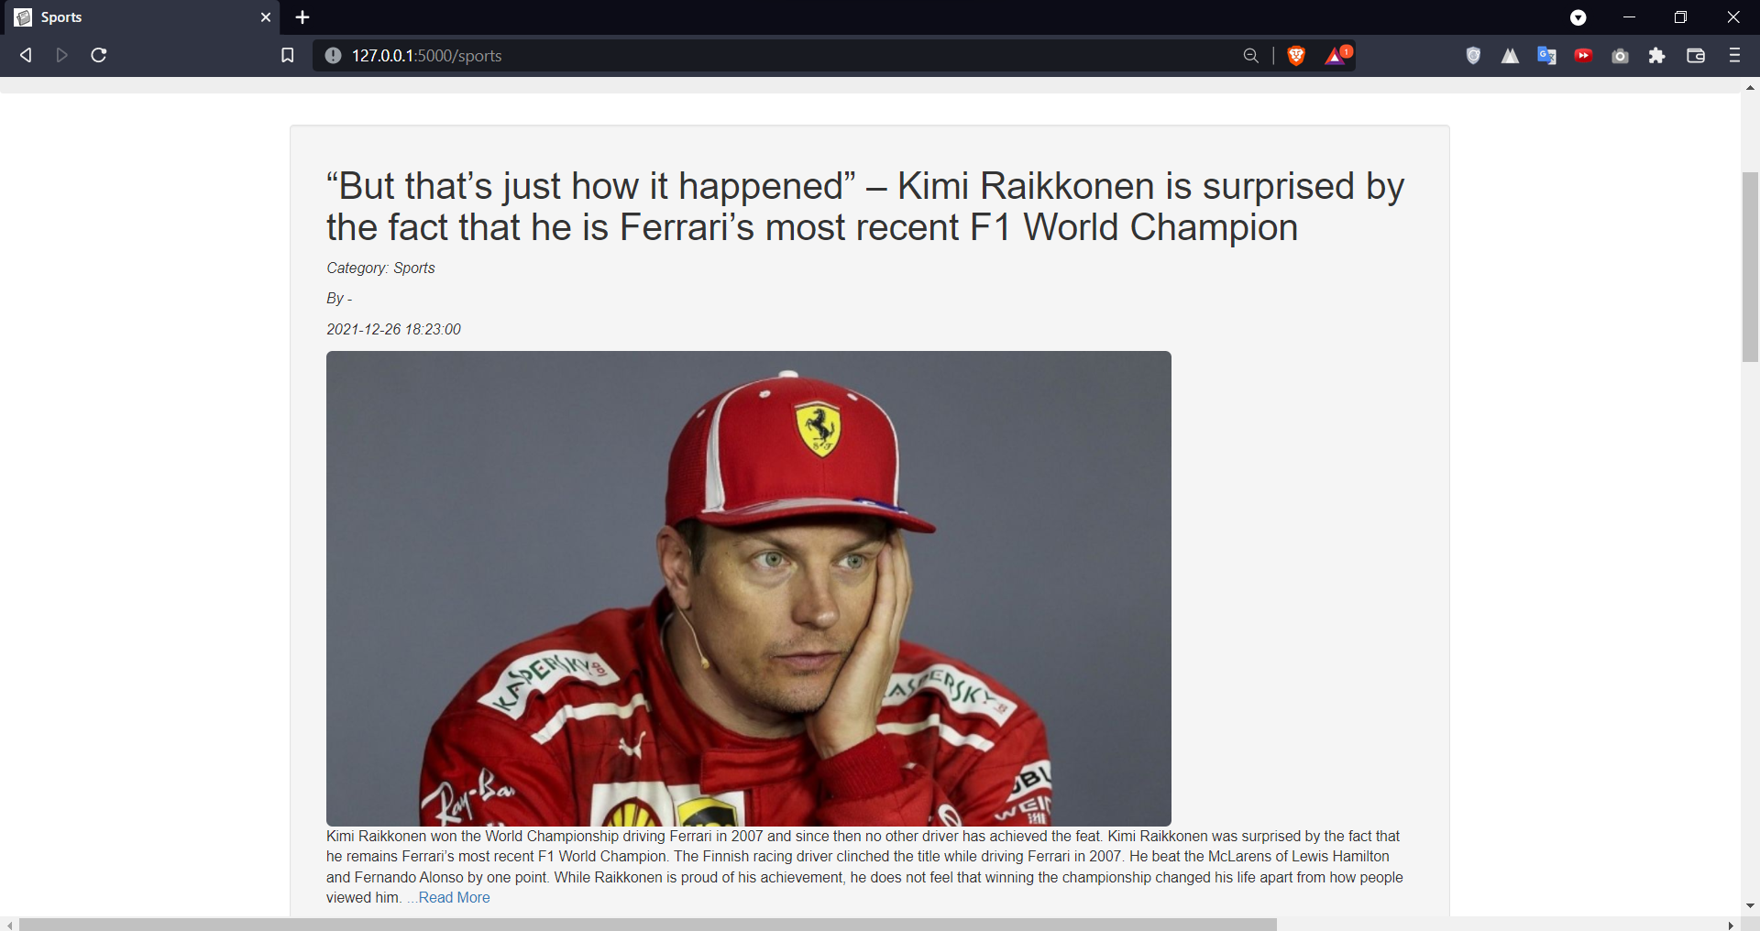
implementation
View News Based on Category

Slide 31
DEMO

